Slide 1
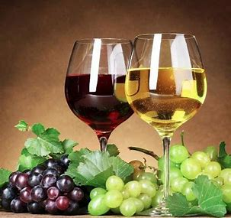
PREDICTING PROFITABLE WINE INGREDIENTS
NAME : DILPA RAO
COMPANY: PROFUSION
DEPARTMENT: DATA SCIENCE

Slide 2
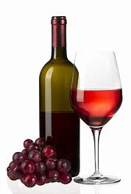
TABLE OF CONTENTS
Introduction
Business Objectives
Data Understanding
Data Pre-processing
Data Visualization
Analysis of Business Objective
Results
Conclusion

Slide 3
INTRODUCTION
Wine which was once viewed as a luxury product is now enjoyed by a variety of customers today.
DRINK TODAY, a leader in manufacturing and selling alcoholic beverages in UK. They want to start a new business line WINE TODAY, with three branches catering low price, medium price and VIP wines in France.
They have approached Profusion who is well known for providing Data Science solutions to international clients like HSBC, Unilever and many more to develop a model for them to predict profitable wine ingredients.
Based on the profitable ingredients in each category five different types of wines will be created.

Slide 4
BUSINESS OBJECTIVES
Exploratory data analysis based on the initial information gathered.
Market analysis of France with the rest of the world.
Analysis of wine tasters world-wide.
Obtain the main ingredients and find the most profitable ones from each wine description.

Slide 5
DATA UNDERSTANDING
The data science team of Profusion gathered an initial dataset
The wine dataset includes the following features.
Data columns (total 8 columns):
country 10583 non-null object
province 10583 non-null object
description 10587 non-null object
points 10587 non-null int64
production_cost 10587 non-null float64
price 9914 non-null float64
taster_name 8511 non-null object
winery 10587 non-null object
dtypes: float64(2), int64(1), object(5)

Slide 6
DATA UNDERSTANDING (CONTD)
There are some missing values in Country, Province, Price and Taster name
country 4
province 4
description 0
Points 0
production_cost 0
Price 673
taster_name 2076
Winery 0
dtype: int64

Slide 7
DATA PRE-PROCESSING
The missing values in Country, Province were found using the winery name and added to the data frame
wine_df.loc[wine_df['winery'] == 'Kakhetia Traditional Winemaking', 'country'] = 'US’
wine_df.loc[wine_df['winery'] == ‘Kakhetia Traditional Winemaking', 'province']='Georgia'
wine_df.loc[wine_df['winery'] == 'Neumeister', 'country'] = 'Austria'
wine_df.loc[wine_df['winery'] == 'Neumeister', 'province']='Straden'
wine_df.loc[wine_df['winery'] == 'El Capricho', 'country'] = 'Uruguay'
wine_df.loc[wine_df['winery'] == 'El Capricho', 'province']='Durazno'
wine_df.loc[wine_df['winery'] == 'Psagot', 'country'] = 'Israel'
wine_df.loc[wine_df['winery'] == 'Psagot', 'province']='West Bank'

Slide 8
DATA PRE-PROCESSING (CONTD)
There were 673 missing values in the price columns and those rows were deleted.
The missing values in the tasters column were left as it is.
There were duplicate values in the description column those rows were deleted.
The final dataframe had 9839 rows .
Country 0
Province 0
Description 0
points 0 production_cost 0
price 0
taster_name 1947
winery 0

Slide 9
DATA PRE-PROCESSING (CONTD)
There are lot of outliers in price, production cost and points.
Name: price, dtype: float64
count 9839.00
Mean 42.19
std 96.42
Min 4.00
25% 17.00
50% 25.00
75% 42.00
max 3300.00
Name: cost
dtype: float64
Count 9839.00
mean 8.50
std 21.59
min 0.69
25% 3.20
50% 5.01
75% 8.48
Max 994.25
Name: points,
dtype: float64
count 9839.00
mean 88.46
Std 3.10
min 80.00
25% 86.00
50% 88.00
75% 91.00
max 100.00

Slide 10
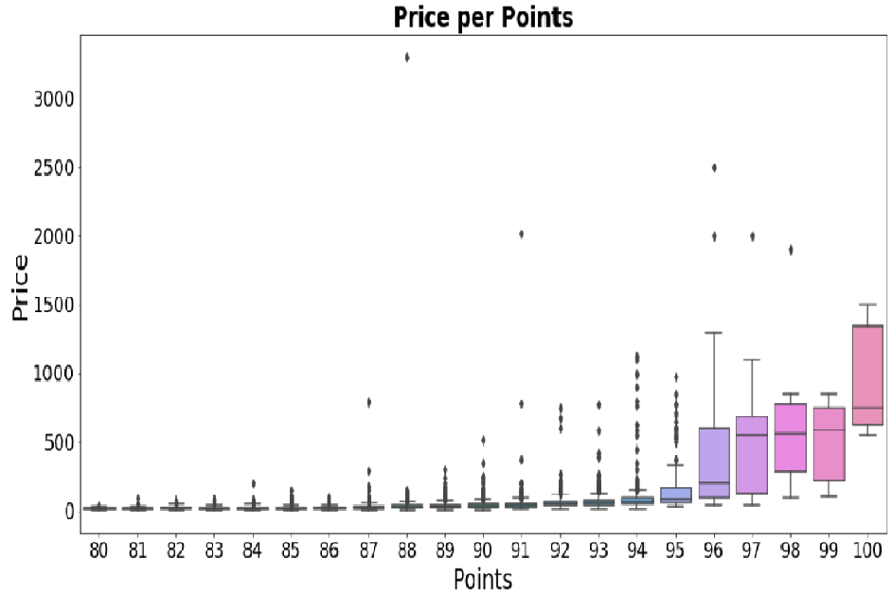
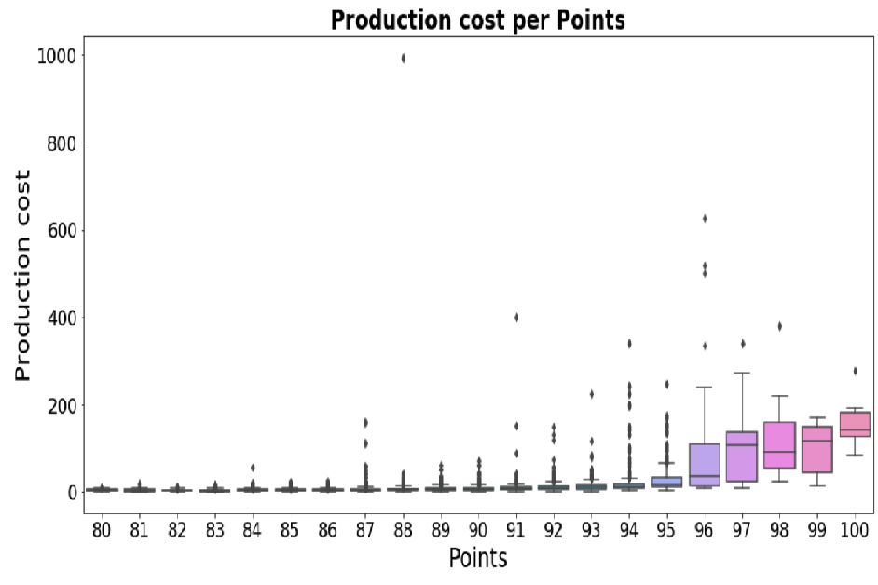
DATA VISUALIZATION
There is a positive correlation between points, production cost price.
There are outliers, which suggest some very high end expensive wines.

Slide 11
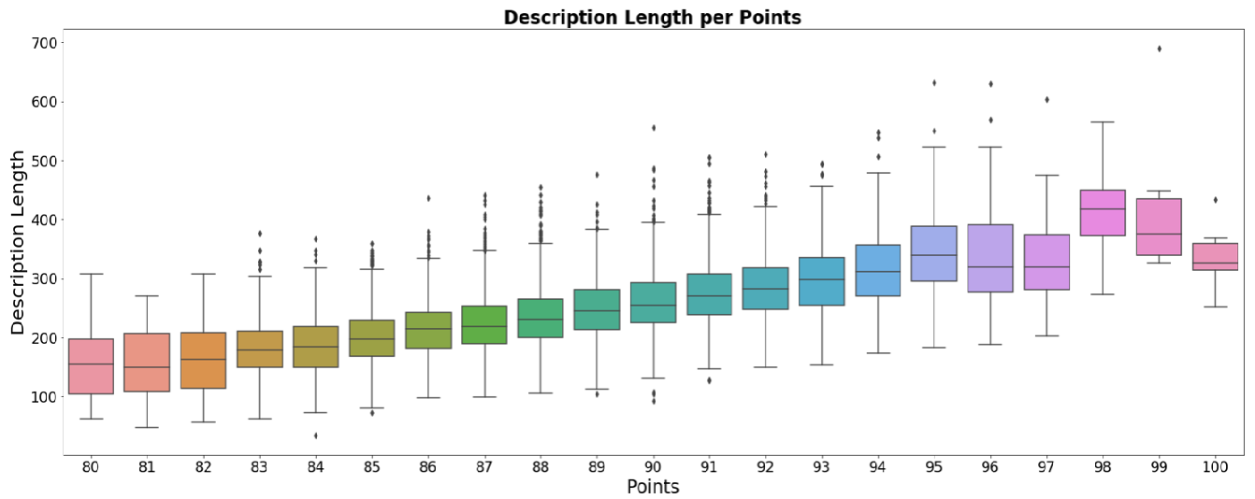
DATA VISUALIZATION (CONTD)
There is a positive correlation between points and description.

Slide 12
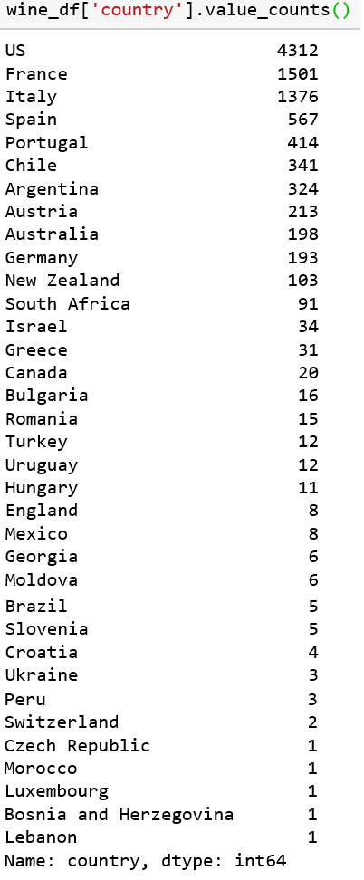
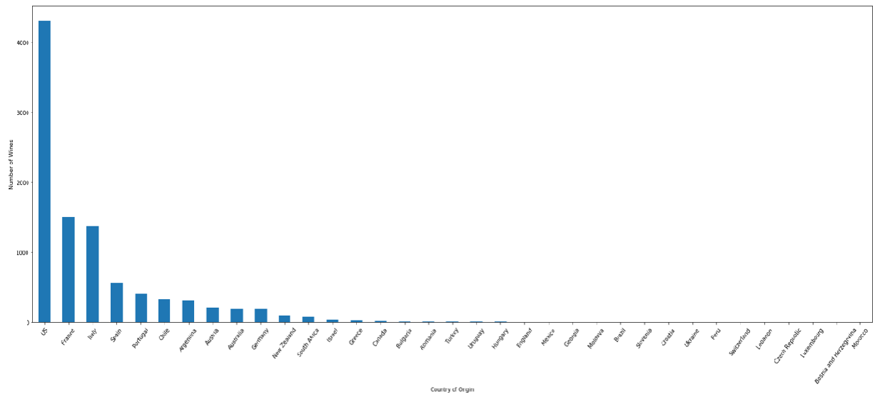
BUSINESS OBJECTIVE ANALYSIS
Nearly 40% wines are from USA , followed by France which accounts for 16% of the world share

Slide 13
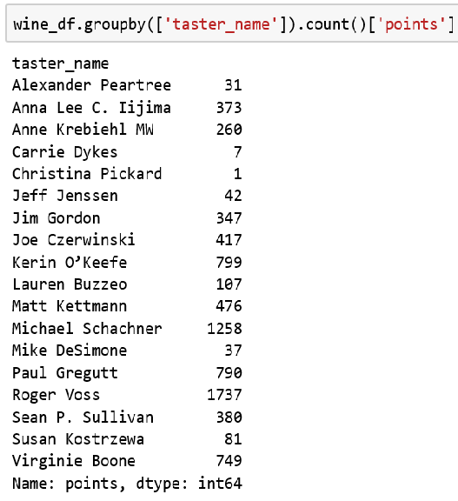
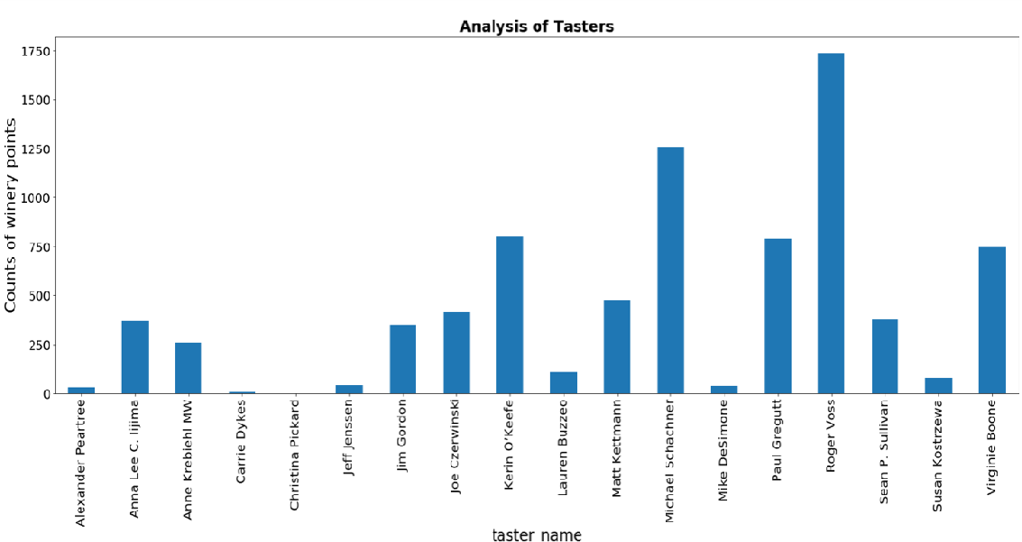
BUSINESS OBJECTIVE ANALYSIS (CONTD)
There are 18 tasters world wide.
The graph shows a summary of number of wines tasted by each of them.

Slide 14
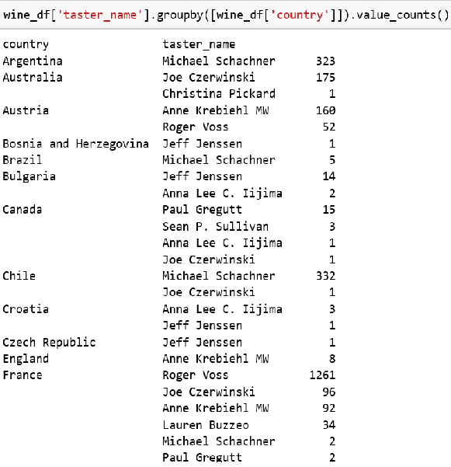
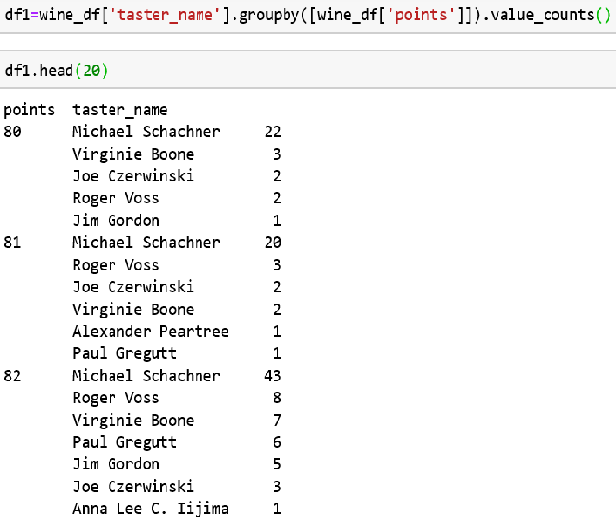
BUSINESS OBJECTIVE ANALYSIS (CONTD)
The left table below illustrates country-wise wines tasted by each of them .
The table on the right shows the count of the points from 80 to 100 given by each taster .

Slide 15
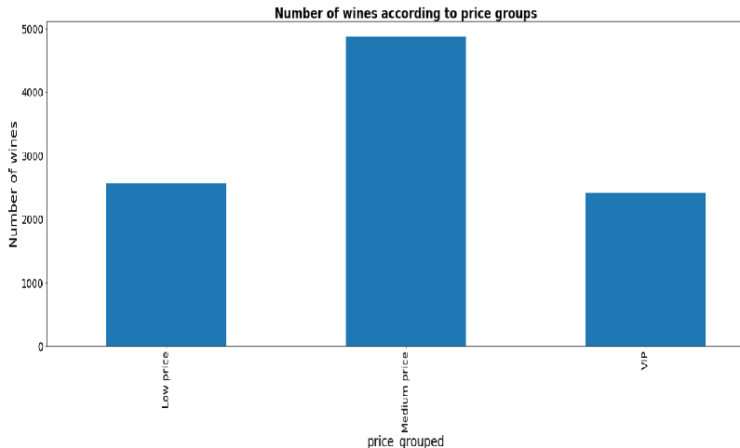
BUSINESS OBJECTIVE ANALYSIS (CONTD)
Additional columns like desc, price_grouped, profit and profit percent were added.
The desc column will contain the main ingredients of each wine , this was done using text analytics.
The price_grouped column comprised of low, medium and VIP calculated using price.
The profit was calculated by subtracting the production cost from the price.
Finally profit percentage was used to find the most profitable wines.

Slide 16
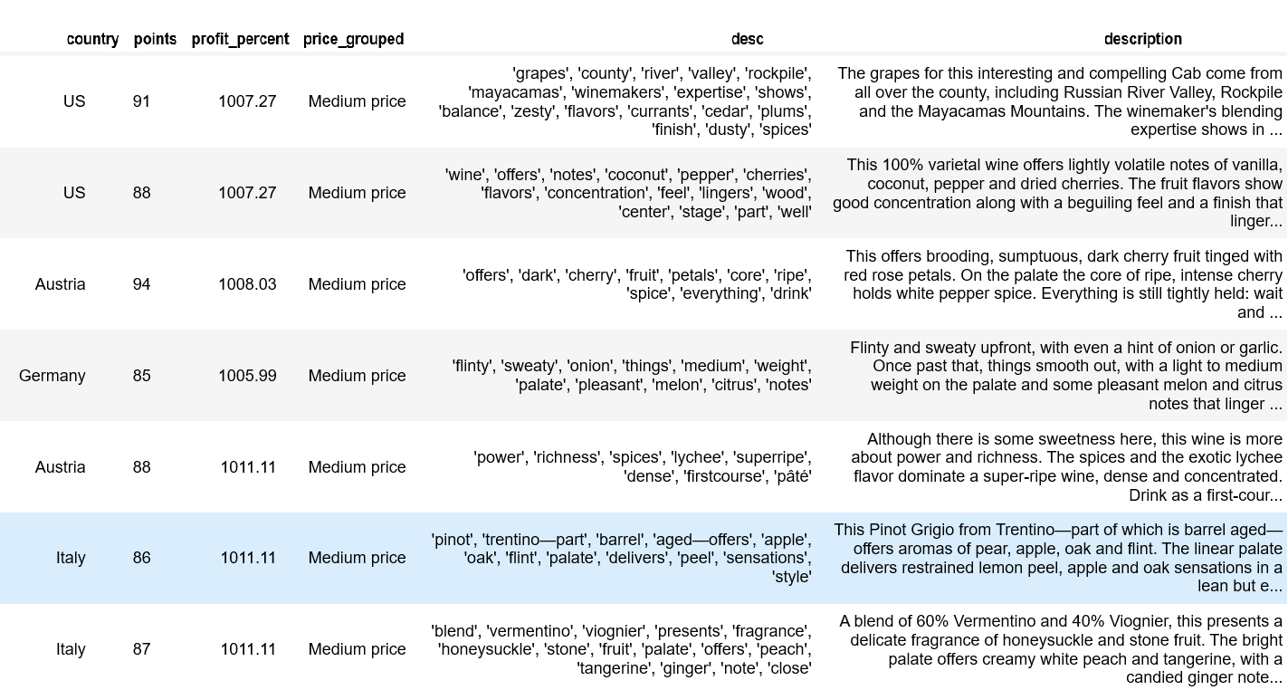
BUSINESS OBJECTIVE ANALYSIS (CONTD)
The main ingredients of each wine from its wine description were obtained using text analytics using the NLTK library functions.

Slide 17
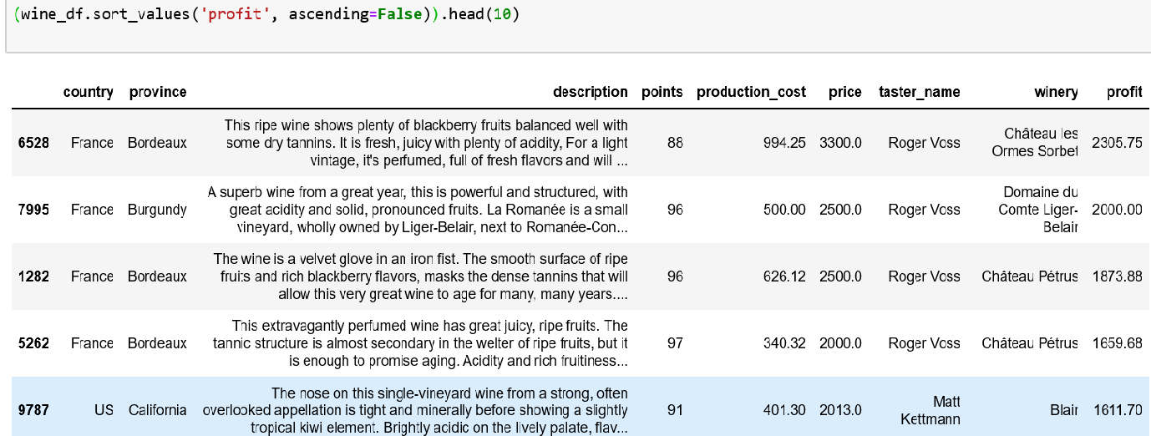
RESULTS
The table below shows the profit for each wine.
The most expensive wines are the ones making the most profit and France has top 4 wines making the maximum profit.

Slide 18
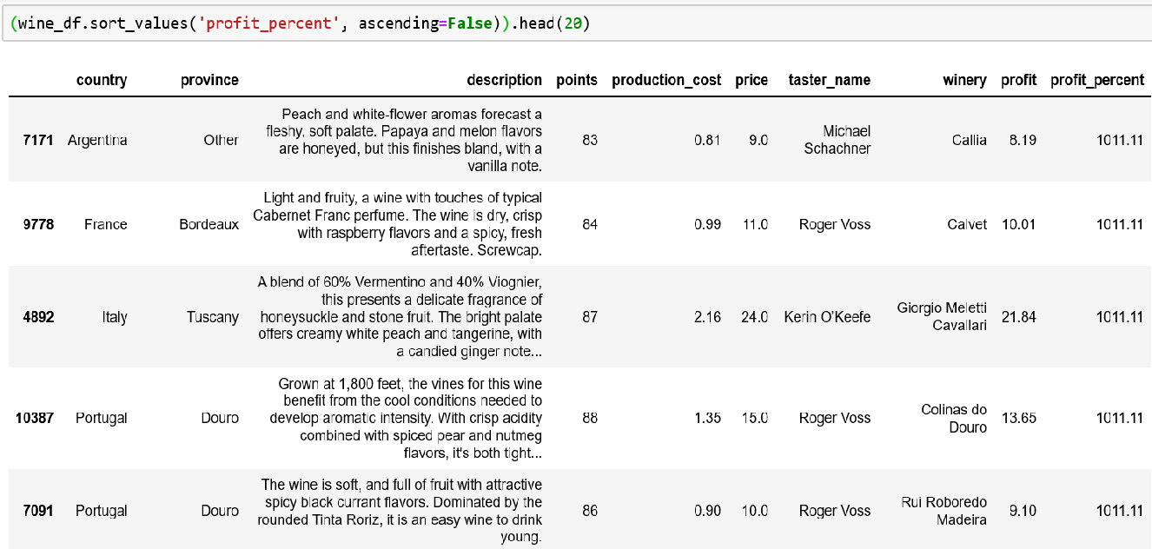
RESULTS (CONTD)
Profit is not a good estimator, we need to see the profit percentage .
This clearly shows that the most expensive wines are not having the most profit percentage.
The most expensive wines are not in the top 5

Slide 19
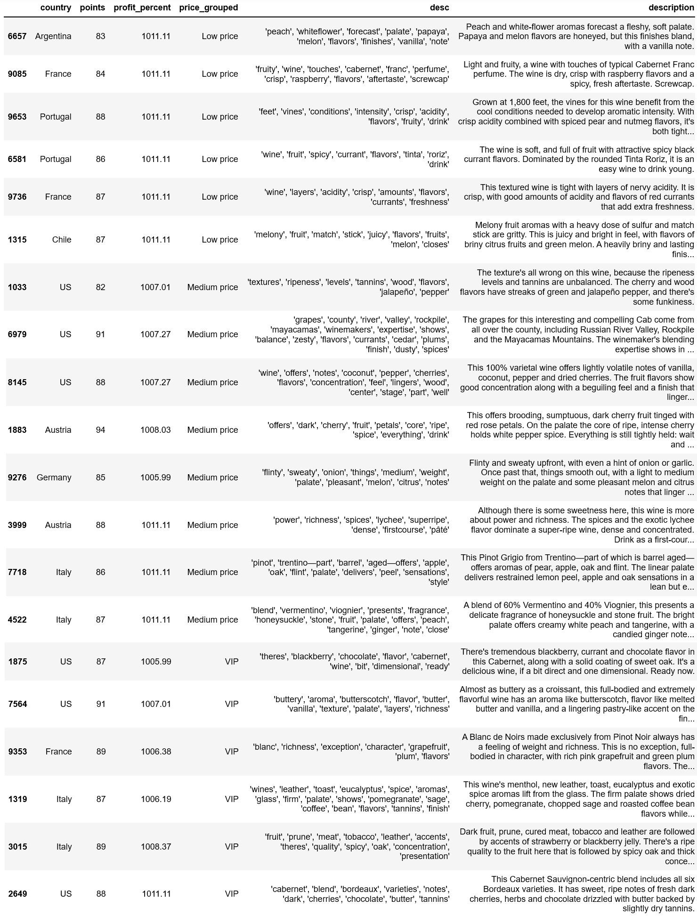
RESULTS (CONTD)
The top 20 wines have the maximum profit percentage will be taken into consideration for finding the profitable ingredients.

Slide 20
RESULTS (CONTD)
Based on the top 20 wines have the maximum profit percentage, the 10 ingredients were selected from each category.
Low price – raspberry , black currant, pear, nutmeg, red currant, vanilla, green melon, tangerine, peach and papaya.
Medium price – cherry, melon, citrus, lychee, apple, peach, tangerine, honeysuckle ,oak and plums.
VIP - pomegranate, cherry, coffee, strawberry, grapefruit, plum, eucalyptus, oak, butterscotch and vanilla.

Slide 21
CONCLUSION
Using kMeans clustering algorithm with k = 5
Create 5 different types of wines with key ingredients and based on these key ingredients use at least 3 of these ingredients.
We could split the dataset into 80-20 train test ratio and train a classifier like Random Forest with the target variable as points to create different wine types with at least a score of 87.
This approach was not tried out due to the complexity of the problem.
Quality certiﬁcation is a crucial step for both wine production and selling and because of the complexity involved, this needs more research and time to obtain accurate results.

Slide 22


